Slide 1
Second Quarter for Fiscal 2025
Earnings Call
February 4, 2025

Slide 2
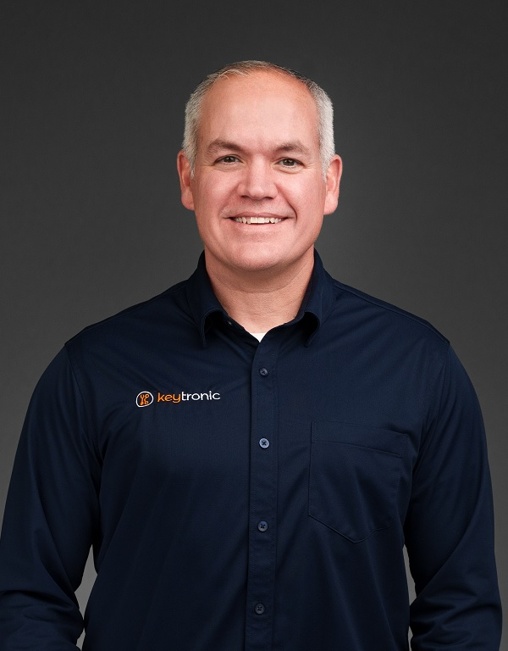
Management On Call Today
Brett Larsen
President and CEO
Tony Voorhees
CFO
2

Slide 3
Notices and Disclaimers
Forward-Looking Statements
Some of the statements in this presentation are forward-looking statements within the meaning of the Private Securities Litigation Reform Act of 1995. Forward-looking statements include, but are not limited to those including such words as aims, anticipates, believes, continues, estimates, expects, hopes, intends, plans, predicts, projects, targets, will, or would, similar verbs, or nouns corresponding to such verbs, which may be forward looking. Forward-looking statements also include other passages that are relevant to expected future events, performances, and actions or that can only be fully evaluated by events that will occur in the future. Forward-looking statements in this presentation include, without limitation, the Company’s statements regarding its expectations with respect to financial conditions and results, including revenue and earnings, cost savings from headcount reduction and the Mexican Peso exchange rate, demand for certain products and the effectiveness of some of its programs, business from customers and programs, and impacts from operational streamlining and efficiencies. There are many factors, risks and uncertainties that could cause actual results to differ materially from those predicted or projected in forward-looking statements, including but not limited to: the future of the global economic environment and its impact on our customers and suppliers; the success and timing of our expansion plans; the availability of components from the supply chain; the availability of a healthy workforce; the accuracy of suppliers’ and customers’ forecasts; development and success of customers’ programs and products; timing and effectiveness of ramping of new programs; success of new-product introductions; the risk of legal proceedings or governmental investigations relating to the previously reported financial statement restatements and related material weaknesses, the May 2024 cybersecurity incident and the subject of the internal investigation by the Company’s Audit Committee and related or other unrelated matters; acquisitions or divestitures of operations or facilities; technology advances; changes in pricing policies by the Company, its competitors, customers or suppliers; impact of new governmental legislation and regulation, including tax reform, tariffs and related activities, such trade negotiations and other risks; and other factors, risks, and uncertainties detailed from time to time in the Company’s SEC filings.
Available Information and Risk Factors
We file annual, quarterly and current reports and other information with the SEC. The SEC filings are available on our website (www.keytronic.com/investor-relations/sec-filings/) and at the SEC’s website (www.sec.gov). These filings describe some of the risks and uncertainties that could affect our business and cause our actual results to differ materially from past or projected results. You should review these filings as they may contain important information about us and our business.
Non-GAAP Financial Measures
This presentation contains certain non-GAAP financial measures, adjusted net income and adjusted net income per share. We provide these non-GAAP financial measures because we believe they provide greater transparency related to our core operations and represent supplemental information used by management in its financial and operational decision making. Additional information about, and reconciliations of, these measures are provided at the end of this slide deck and in our earnings release, which is posted to the investor relations section of our website: www.keytronic.com/investor-relations/press-releases/.
3

Slide 4
Revenue Highlights
 | FY2025 | FY2024
Second Quarter | $113.9M | $147.8M
Year-to-date | $245.4M | $298.0M
Approx. $15M of revenue impacted by:
Unexpected shortages for specific components managed by a large customer.
Lower-than-expected production during holiday season and reduced demand from certain customers.
Revenue is expected to rebound in third quarter.
4

Slide 5
Margins and Interest Expense
 | Q2-FY2025 | Q2-FY2024
Gross Margin | 6.8% | 8.0%
Operating Margin | (1.0%) | 2.7%
Interest Expense | $3.9M | $3.0M
Margin decline primarily reflects unexpected reduction of revenue.
Expect margins to strengthen on higher revenue, improved operating efficiencies, and continued benefits of strategic cost-saving.
Tariffs create significant uncertainties about costs and margin performance in coming quarters.
Approx. $1.0 million in write-offs of unamortized loan fees related to refinancing debt.
5

Slide 6
Earnings – GAAP
 | Q2-FY2025 | Q2-FY2024
Net Income (Loss) | ($4.9M) | $1.1M
Net Income (Loss) Per Share – Diluted | ($0.46) | $0.10
 | YTD-FY2025 | YTD-FY2024
Net Income (Loss) | ($3.8M) | $1.4M
Net Income (Loss) Per Share – Diluted | ($0.35) | $0.13
6

Slide 7
Earnings – Non-GAAP
 | Q2-FY2025 | Q2-FY2024
Adjusted Net Income (Loss) | ($4.1M) | $1.1M
Adjusted Net Income (Loss) Per Share – Diluted | ($0.38) | $0.10
 | YTD-FY2025 | YTD-FY2024
Adjusted Net Income (Loss) | ($2.9M) | $1.2M
Adjusted Net Income (Loss) Per Share – Diluted | ($0.27) | $0.11
7

Slide 8
Balance Sheet and CapEx Highlights
 | Q2-FY2025 | Q2-FY2024 | % Change
Inventory | $100.7M | $124.1M | -19%
Total Liabilities | $208.3M | $246.3M | -15%
Current Ratio | 2.8 | 2.6 | +8%
DSOs | 99 | 83 | +19%
Capital Expenditures | $0.8M | $2.6M | -69%
8

Slide 9
Outlook
New programs ramping and efficiency improvements.
Reduced demand from certain longstanding customers.
Uncertainties related to newly announced increases in tariffs.
Given the current economic and political landscape it is too difficult to quantify cost impact of tariffs.
Not issuing revenue or earnings guidance for the third quarter of fiscal year 2025.
Over longer term, we believe we are increasingly well positioned to win new programs and profitably expand business.
9

Slide 10
Q2-2025 Highlights
Unexpected decline in revenue
Expect revenue and earnings to recover in Q3-FY2025
Refinanced credit facility, maturing December 2029
Streamlining international and domestic operations, with further headcount reductions
Building on similar actions a year ago.
Inventory levels more in line with current revenue levels.
Expect strategic changes will improve overall profitability.
Significantly increasing production capacity in Arkansas and Vietnam
10

Slide 11
Expanding Customer Base in Q2-FY2025
Aerospace systems
Energy resiliency technology:
Expected to begin manufacturing in 2H-2025.
Once fully ramped, annual revenue could exceed $60 million.
11

Slide 12
Continuing Macro Drivers
Expect global logistics problems, geopolitical tensions and new tariffs will drive OEMs to re-examine outsourcing strategies
We believe OEMs realize they are overly dependent on China for not only manufacturing, but for design and logistics
Decision to on-shore becoming smart long-term strategy
Continued increases in Mexican wages
Customers using different calculus for selecting geographic location for business
12

Slide 13
Expanding US and Vietnam Production
US facilities:
Designed to provide ultimate in flexibility, engineering support, and ease of communications
Expect to see increased demand and new programs in coming quarters.
Planning to significantly increase size of Arkansas facilities by June 2025.
Vietnam facilities:
Offers high-quality, low-cost choice associated with China and Mexico in the past.
Planning to double capacity by September 2025.
Expected to play major role in long-term growth.
13

Slide 14
One-Stop-Shop
Combination of global footprint and expansive design capabilities capturing new business
Many large/medium-sized program wins predicated on our deep and broad design services
We believe our knowledge of specific design challenges makes business extremely sticky
Continue to invest in vertical integration and manufacturing process knowledge => we believe this increasingly sets us apart from competitors
Wide range of plastic molding – injection, blow, gas assist, and multi-shot
PCB assembly, metal forming, painting and coating, complex high volume automated assembly
Design construction and complicated test equipment

Slide 15
Looking Forward
Macro business drivers expected to continue unabated
Strong pipeline of potential new business
Seeing significant improvements in operating efficiencies
Continuing to rebalance manufacturing across facilities in US and Vietnam
Remain encouraged by progress and potential for profitable growth over long term
15

Slide 16
Q & A
16

Slide 17
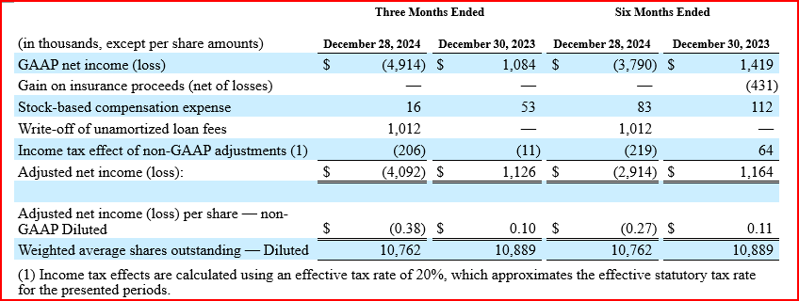
Appendix: Non-GAAP Reconciliations

