Slide 1
Fourth Quarter and Year End
for Fiscal 2025 Earnings Call
August 27, 2025

Slide 2
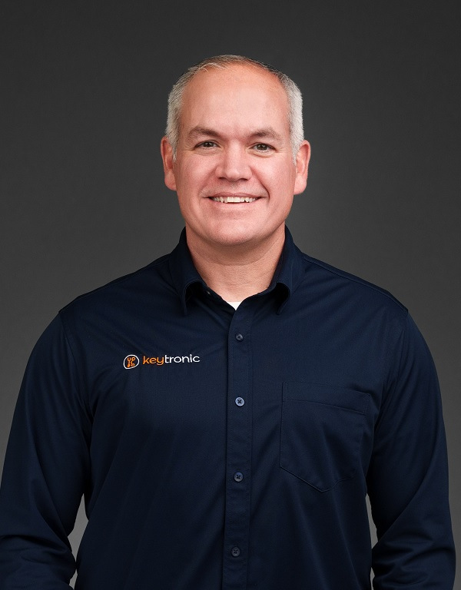

Management On Call Today
Brett Larsen
President and CEO
Tony Voorhees
CFO
2

Slide 3
Notices and Disclaimers
Forward-Looking Statements
Some of the statements in this press release are forward-looking statements within the meaning of the Private Securities Litigation Reform Act of 1995. Forward-looking statements include, but are not limited to those including such words as aims, anticipates, believes, continues, estimates, expects, hopes, intends, plans, predicts, projects, targets, will, or would, similar verbs, or nouns corresponding to such verbs, which may be forward looking. Forward-looking statements also include other passages that are relevant to expected future events, performances, and actions or that can only be fully evaluated by events that will occur in the future. Forward-looking statements in this release include, without limitation, the Company’s statements regarding its expectations with respect to financial conditions and results, including revenue, earnings, and margins, the Company’s ability to build out production capacity in the US and Vietnam and the timing of completion of those facilities, cost savings from headcount reduction, demand for certain products and the effectiveness of some of its programs, business from customers and programs, and impacts from operational streamlining and efficiencies, including reductions in inventories. There are many factors, risks and uncertainties that could cause actual results to differ materially from those predicted or projected in forward-looking statements, including but not limited to: the future of the global economic environment and its impact on our customers and suppliers; the impact of new governmental legislation and regulation, including tax reform, tariffs and related activities, such as trade negotiations and other risks; the success and timing of our expansion plans; the availability of components from the supply chain; the availability of a healthy workforce; the accuracy of suppliers’ and customers’ forecasts; development and success of customers’ programs and products; timing and effectiveness of ramping of new programs; success of new-product introductions; the risk of legal proceedings or governmental investigations relating to the previously reported financial statement restatements and related material weaknesses, the May 2024 cybersecurity incident and the subject of the internal investigation by the Company’s Audit Committee and related or other unrelated matters; acquisitions or divestitures of operations or facilities; technology advances; changes in pricing policies by the Company, its competitors, customers or suppliers; and other factors, risks, and uncertainties detailed from time to time in the Company’s SEC filings.
Available Information and Risk Factors
We file annual, quarterly and current reports and other information with the SEC. The SEC filings are available on our website (www.keytronic.com/investor-relations/sec-filings/) and at the SEC’s website (www.sec.gov). These filings describe some of the risks and uncertainties that could affect our business and cause our actual results to differ materially from past or projected results. You should review these filings as they may contain important information about us and our business.
Non-GAAP Financial Measures
This presentation contains certain non-GAAP financial measures, adjusted net income and adjusted net income per share. We provide these non-GAAP financial measures because we believe they provide greater transparency related to our core operations and represent supplemental information used by management in its financial and operational decision making. Additional information about, and reconciliations of, these measures are provided at the end of this slide deck and in our earnings release, which is posted to the investor relations section of our website: www.keytronic.com/investor-relations/press-releases/.
3

Slide 4
Revenue Highlights
 | FY2025 | FY2024
Fourth Quarter | $110.5M | $126.6M
Full Year | $467.9M | $566.9M
  2 longstanding customers reduced demand
  Escalation/fluctuations in global tariffs caused uncertainty
    Contributed to delays in new programs
4

Slide 5
Margins
 | Q4-FY2025 | Q4-FY2024 | FY 2025 | FY2024
Gross Margin | 6.2% | 7.2% | 7.8% | 7.0%
Operating Margin | (2.1%) | 0.1% | 0.1% | 1.2%
  Q4 margin decreases largely relate to reductions in demand from 2 longstanding customers
  Year-over-year increases due to operational efficiencies gained from reductions in workforce over last two years
    Reduced headcount by approximately 300 employees during Q4
    Total headcount reduction of approximately 800 during year
  Well positioned for growth and return to profitability
    Expect margins to strengthen on higher revenue, improved operating efficiencies, and continued benefits of strategic cost-saving
5

Slide 6
Earnings – GAAP
 | Q4-FY2025 | Q4-FY2024
Net Loss | ($3.9M) | ($2.0M)
Net Loss Per Share – Diluted | ($0.36) | ($0.18)
 | FY2025 | FY2024
Net Loss | ($8.3M) | ($2.8M)
Net Loss Per Share – Diluted | ($0.77) | ($0.26)
6

Slide 7
Earnings – Non-GAAP
 | Q4-FY2025 | Q4-FY2024
Adjusted Net Loss | ($3.8M) | ($0.7M)
Adjusted Net Loss Per Share – Diluted | ($0.35) | ($0.06)
 | FY2025 | FY2024
Adjusted Net Loss | ($5.0M) | ($0.2M)
Adjusted Net Loss Per Share – Diluted | ($0.47) | ($0.02)
7

Slide 8
Balance Sheet and Cash Flow Highlights
 | FY2025 | FY2024 | % Change
Inventory | $97.3M | $105.1M | -7%
Total Liabilities | $198.7M | $231.4M | -14%
Current Ratio | 2.5 | 2.8 | -11%
DSOs | 86 | 95 | 9%
Operating Cash Flows | $18.9M | $13.8M | 37%
Capital Expenditures | $4.1M | $4.0M | 3%
8

Slide 9
Outlook
  New programs ramping and efficiency improvements taking hold
  Expect growth in US and Vietnam
  Strong pipeline of new business
  Over longer term, believe we are increasingly well positioned to win new programs and profitably expand business
  Not issuing revenue or earnings guidance for the first quarter of fiscal 2026
9

Slide 10
2025 Highlights
Fiscal 2025 was a year of transition and uncertainty
Despite reduction of demand from two longstanding customers, we had expected to fill void with new programs
Uncertainty of tariffs delayed most of new program launches into fiscal 2026
Right-sized cost structure in Mexico and introduced new production efficiencies and automation
Transitioned manufacturing footprint by investing in US and Vietnam
10

Slide 11
Tariff Challenges
Sudden increases/decreases in tariffs impacted production across all facilities
Working with suppliers/customers on manufacturing products from different locations to mitigate impact of tariffs
Changes to manufacturing footprint and cost reductions enable improved mitigation options
11

Slide 12
Expanding US and Vietnam Production
US facilities:
  Expanding clean-tech, cutting-edge manufacturing operations in Arkansas
  Expect to invest over $28 million in new flagship manufacturing and R&D location
  Believe this will create over 400 new jobs over the next five years.
  Vietnam facilities:
    Planning to double capacity and adding medical device capabilities
    Offers high-quality, low-cost choice associated with China and Mexico in the past
    Expected to play major role in long-term growth
  Anticipate new facilities in US and Vietnam coming online in FY26
    Expect approximately half of production in US and Vietnam by end FY26
12

Slide 13
Streamlining Mexico Production
Mexico facility offers unique solution for tariff mitigation under USMCA
But sustained trend of continued wage increases in Mexico
Streamlined operations, increased efficiencies and invested in automation
During fiscal 2025, reduced headcount by approximately 800 (or 30%), mostly in Mexico.
Improved cost structure in Mexico anticipated to lead to new programs and growth
13

Slide 14
Expanding Customer Base in FY2025
Manufacturing equipment
Vehicle lighting
Aerospace systems
Energy resiliency
Telecommunications,
Pest control
Energy storage
Medical technology
Temperature-controlled shipping
Personal protection
Air purification
Automotive
Utilities inspection
Data processing (New)
14

Slide 15
One-Stop-Shop
Combination of flexible global footprint and expansive design capabilities capturing new business
  Many program wins predicated on our deep and broad design services
  Believe our knowledge of specific design challenges makes business extremely sticky
Continue to invest in vertical integration and manufacturing process knowledge => believe this increasingly sets us apart from competitors
  Wide range of plastic molding – injection, blow, gas assist, and multi-shot
  PCB assembly, metal forming, painting and coating, complex high volume automated assembly
  Design construction and complicated test equipment

Slide 16
Looking Forward
Global tariffs creating major near-term challenges but driving favorable long-term trends
Continuing to rebalance manufacturing across facilities in US and Vietnam
Strong pipeline of potential new business
Seeing significant improvements in operating efficiencies
Remain encouraged by progress and potential for profitable growth over long term
16

Slide 17
Thank You to Our Dedicated Employees
Challenging year for industry and for Key Tronic.
Execution of strategy made possible by our investments in plants and equipment ̶ but even more so because of the skills, local knowledge and talents of our people
Many thanks to our exceptional employees for their dedication and hard work
17

Slide 18
Q & A
18

Slide 19
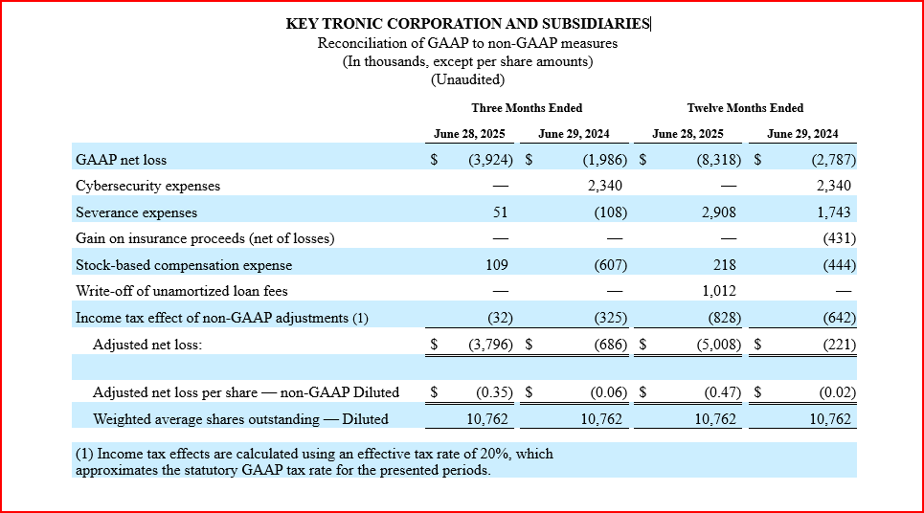
Appendix: Non-GAAP Reconciliations

