Slide 1
Second Quarter of Fiscal 2026 Earnings Call
February 3, 2026

Slide 2
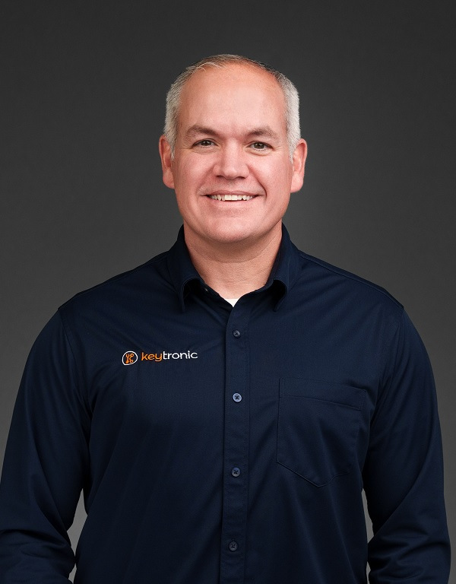

Management On Call Today
Brett Larsen
President and CEO
Tony Voorhees
CFO
2

Slide 3
Notices and Disclaimers
Forward-Looking Statements
Some of the statements in this presentation and accompanying press release are forward-looking statements within the meaning of the Private Securities Litigation Reform Act of 1995. Forward-looking statements include, but are not limited to those including such words as aims, anticipates, believes, continues, estimates, expects, hopes, intends, plans, predicts, projects, targets, will, or would, similar verbs, or nouns corresponding to such verbs, which may be forward looking. Forward-looking statements also include other passages that are relevant to expected future events, performances, and actions or that can only be fully evaluated by events that will occur in the future. Forward-looking statements in this presentation and accompanying release include, without limitation, the Company’s statements regarding its expectations with respect to financial conditions and results, including revenue, earnings, and margins, the Company’s ability to shift its focus in China and build out production capacity in the US and Vietnam and the timing of completion of those facilities, cost savings from headcount reduction and the wind-down of manufacturing operations in China, demand for certain products and the effectiveness of some of its programs, business from customers and programs, and impacts from operational streamlining and efficiencies, including reductions in inventories. There are many factors, risks and uncertainties that could cause actual results to differ materially from those predicted or projected in forward-looking statements, including but not limited to: the future of the global economic environment and its impact on our customers and suppliers; the impact of new governmental legislation and regulation, including tax reform, tariffs and related activities, such as trade negotiations and other risks; the success and timing of our expansion plans; the availability of components from the supply chain; the availability of a healthy workforce; the accuracy of suppliers’ and customers’ forecasts; development and success of customers’ programs and products; timing and effectiveness of ramping of new programs; success of new-product introductions; the risk of legal proceedings or governmental investigations relating to the previously reported financial statement restatements and related material weaknesses, the May 2024 cybersecurity incident and the subject of the internal investigation by the Company’s Audit Committee and related or other unrelated matters; acquisitions or divestitures of operations or facilities; technology advances; changes in pricing policies by the Company, its competitors, customers or suppliers; and other factors, risks, and uncertainties detailed from time to time in the Company’s SEC filings.
Available Information and Risk Factors
We file annual, quarterly and current reports and other information with the SEC. The SEC filings are available on our website (www.keytronic.com/investor-relations/sec-filings/) and at the SEC’s website (www.sec.gov). These filings describe some of the risks and uncertainties that could affect our business and cause our actual results to differ materially from past or projected results. You should review these filings as they may contain important information about us and our business.
Non-GAAP Financial Measures
This presentation contains certain non-GAAP financial measures, adjusted net income (loss), adjusted net income (loss) per share, adjusted cost of sales, adjusted gross profit, and adjusted gross margin. We provide these non-GAAP financial measures because we believe they provide greater transparency related to our core operations and represent supplemental information used by management in its financial and operational decision making. Additional information about, and reconciliations of, these measures are provided at the end of this slide deck and in our earnings release, which is posted to the investor relations section of our website: www.keytronic.com/investor-relations/press-releases/.
3

Slide 4
Revenue Highlights
 | FY2026 | FY2025
Second Quarter | $96.3M | $113.9M
Year-to-date | $195.1M | $245.4M
Longstanding customer reduced demand and transition of end-of-life program
Partially offset by new program wins and increased demand from other longstanding customers
Continued uncertainty in global economy and volatile trade polices
Continue ramping consigned materials program
4

Slide 5
Margins
 | Q2-FY2026 | Adjusted Q2-FY2026 | Q2-FY2025
Gross Margin | 0.6% | 7.9% | 6.8%
Operating Margin | (10.7%) | -- | (1.0%)
Advanced near-shoring and tariff mitigation strategies to reduce costs:
Wind-down of manufacturing operations in China => anticipate saving ~$1.2M per quarter
Further reduced workforce in Mexico => anticipate saving ~ $1.5M per quarter
Severance, inventory write-offs and other related expenses of $10.5M for quarter => significant adverse impact on margins
Expect margins to strengthen on higher revenue, driven by improved operating efficiencies and continued benefits of strategic cost-saving
5

Slide 6
Earnings – GAAP
 | Q2-FY2026 | Q2-FY2025
Net Income (Loss) | ($8.6M) | ($4.9M)
Net Income (Loss) Per Share – Diluted | ($0.79) | ($0.46)
 | YTD-FY2026 | YTD-FY2025
Net Income (Loss) | ($10.8M) | ($3.8M)
Net Income (Loss) Per Share – Diluted | ($1.00) | ($0.35)
6

Slide 7
Earnings – Non-GAAP
 | Q2-FY2026 | Q2-FY2025
Adjusted Net Income (Loss) | $0.0M | ($4.1M)
Adjusted Net Income (Loss) Per Share – Diluted | $0.00 | ($0.38)
 | YTD-FY2026 | YTD-FY2025
Adjusted Net Income (Loss) | ($1.1M) | ($1.3M)
Adjusted Net Income (Loss) Per Share – Diluted | ($0.10) | ($0.12)
7

Slide 8
Balance Sheet and Cash Flow Highlights
 | Q2-FY2026 | Q2-FY2025 | % Change
Inventory | $88.4M | $100.7M | 12%
Current Ratio | 2.0 | 2.8 | -29%
DSOs | 77 | 99 | -22%
Operating Cash Flows | $6.3M | $1.5M | 320%
Total Debt | $97.7M | $111.1M | -12%
Capital Expenditures | $3.3M | $0.4M | 725%
8

Slide 9
Outlook
Continue to face global economic uncertainties and volatile trade policies
New programs gradually ramping
Efficiency improvements taking hold
Expect growth in US and Vietnam
Strong pipeline of new business
Over longer term, believe we are increasingly well positioned to win new programs and profitably expand business
Not issuing guidance for third quarter of fiscal 2026
9

Slide 10
Q2-2026 Highlights
Providing customers with options to better manage macroeconomic uncertainties and enhance potential for profitable long-term growth
Significant investments in US and Vietnam locations:
Increasing number of customer program starts in Arkansas,
Started new production line in Mississippi
Shipped first batch of medical products from Vietnam
Due to ongoing geopolitical tensions and tariff uncertainties:
Winding down manufacturing operations in China facility
Continue to right-size Mexico facility
10

Slide 11
Market Challenges
Demand from longstanding customer has declined in recent periods, but we believe recently won programs more than offset
Continued market uncertainty and tariffs impacted timing and launch of new programs, but those programs continue to proceed
Working with suppliers/customers on manufacturing products from different locations to mitigate impact of tariffs
Changes to manufacturing footprint and cost reductions enable improved mitigation options
11

Slide 12
Major Cost-Cutting in China and Mexico
China operations:
Continuing geopolitical tensions, tariff uncertainties and increasing costs
Winding down China facilities and transferring several programs to Vietnam
Continue to operate in China with small team focused on sourcing
Mexico operations:
Over past 18 months, reduced headcount by ̴ 40% in Mexico and transferring some programs from Mexico to US and Vietnam
Mexico facility offers unique solution for tariff mitigation under USMCA
Streamlined operations, increased efficiencies and invested in automation
Improved cost structure in Mexico anticipated to lead to new programs and growth
12

Slide 13
Expanding US and Vietnam Production
US facilities:
New clean-tech, cutting-edge manufacturing and R&D operations in Arkansas
Provides customers with outstanding flexibility, engineering support, and ease of communications
Expect double-digit growth in Arkansas during 2H-FY2026
Vietnam facilities:
Doubled capacity and added medical device capabilities
Offers high-quality, low-cost choice previously associated with China
Expected to play major role in long-term growth
Expect approximately half of production in US and Vietnam by end FY2026
13

Slide 14
Expanding Customer Base in Q2-FY2026
Automotive technology
Pest control
Industrial equipment
Ramping manufacturing services contract for data processing OEM
14

Slide 15
One-Stop-Shop
Combination of flexible global footprint and expansive design capabilities capturing new business
Many program wins predicated on our deep and broad design services
Believe our knowledge of specific design challenges makes business extremely sticky
Continue to invest in vertical integration and manufacturing process knowledge => believe this increasingly sets us apart from competitors
Wide range of plastic molding – injection, blow, gas assist, and multi-shot
PCB assembly, metal forming, painting and coating, complex high volume automated assembly
Design construction and complicated test equipment

Slide 16
Looking Forward
Global market uncertainties creating major near-term challenges but driving favorable long-term trends
Expecting revenue growth in coming quarters from new programs launching in U.S., Mexico and Vietnam
Strong pipeline of potential new business
Anticipating significant improvements in operating efficiencies
Remain encouraged by progress and potential for profitable growth over long term
16

Slide 17
Q & A
17

Slide 18
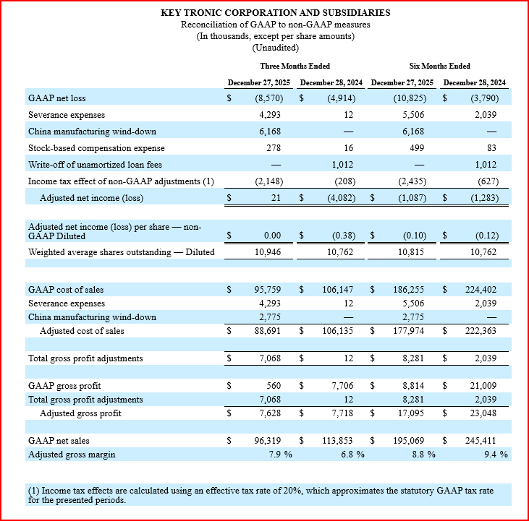
Appendix: Non-GAAP Reconciliations

