Slide 1
Third Quarter of Fiscal 2026 Earnings Call
May 5, 2026

Slide 2
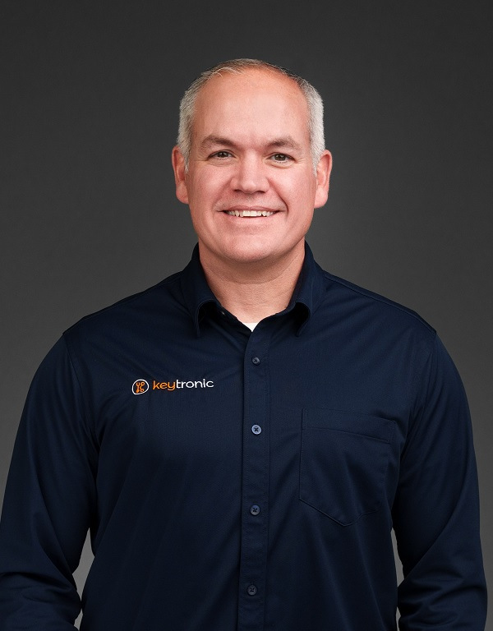

Management On Call Today
Brett Larsen
President and CEO
Tony Voorhees
CFO
2

Slide 3
Notices and Disclaimers
Forward-Looking Statements
Some of the statements in this press release are forward-looking statements within the meaning of the Private Securities Litigation Reform Act of 1995. Forward-looking statements include, but are not limited to those including such words as aims, anticipates, believes, continues, estimates, expects, hopes, intends, plans, predicts, projects, targets, will, or would, similar verbs, or nouns corresponding to such verbs, which may be forward looking. Forward-looking statements also include other passages that are relevant to expected future events, performances, and actions or that can only be fully evaluated by events that will occur in the future. Forward-looking statements in this release include, without limitation, the Company’s statements regarding its expectations with respect to financial conditions and results, including revenue, earnings, and margins, the Company’s ability to shift its focus in China and build out production capacity in the US and Vietnam and the timing of completion of those facilities, cost savings from headcount reduction and the wind-down of manufacturing operations in China, demand for certain products and the effectiveness of some of its programs, business from customers and programs, new program launches, impacts from operational streamlining and efficiencies, including reductions in inventories, and impacts of repairs to its facilities from winter storm damage. There are many factors, risks and uncertainties that could cause actual results to differ materially from those predicted or projected in forward-looking statements, including but not limited to: the future of the global economic environment and its impact on our customers and suppliers; the impact of new governmental legislation and regulation, including tax reform, tariffs and related activities, such as trade negotiations and other risks; the success and timing of our expansion plans; the availability of components from the supply chain; the availability of a healthy workforce; the accuracy of suppliers’ and customers’ forecasts; development and success of customers’ programs and products; timing and effectiveness of ramping of new programs; success of new-product introductions; the risk of legal proceedings relating to the previously reported financial statement restatements and related material weaknesses, the May 2024 cybersecurity incident and the subject of the internal investigation by the Company’s Audit Committee and related or other unrelated matters; acquisitions or divestitures of operations or facilities; technology advances; changes in pricing policies by the Company, its competitors, customers or suppliers; and other factors, risks, and uncertainties detailed from time to time in the Company’s SEC filings.
Available Information and Risk Factors
We file annual, quarterly and current reports and other information with the SEC. The SEC filings are available on our website (www.keytronic.com/investor-relations/sec-filings/) and at the SEC’s website (www.sec.gov). These filings describe some of the risks and uncertainties that could affect our business and cause our actual results to differ materially from past or projected results. You should review these filings as they may contain important information about us and our business.
Non-GAAP Financial Measures
This presentation contains certain non-GAAP financial measures, adjusted net income (loss), adjusted net income (loss) per share, adjusted cost of sales, adjusted gross profit, and adjusted gross margin. We provide these non-GAAP financial measures because we believe they provide greater transparency related to our core operations and represent supplemental information used by management in its financial and operational decision making. Additional information about, and reconciliations of, these measures are provided at the end of this slide deck and in our earnings release, which is posted to the investor relations section of our website: www.keytronic.com/investor-relations/press-releases/.
3

Slide 4
Revenue Highlights
 | FY2026 | FY2025
Third Quarter | $89.6M | $112.0M
Year-to-date | $284.6M | $357.4M
  Decreases due to reduced demand from legacy customer and end-of-life program
  Adverse impacts from Winter Storm Fern, customer related design delays, and delays in receiving allocated components
  Expect revenue growth as demand returns from legacy customers and new programs continue to launch/ramp
4

Slide 5
Margins
 | Q3-FY2026 | Adjusted Q3-FY2026 | Q3-FY2025
Gross Margin | 8.0% | 8.5% | 7.7%
Operating Margin | (0.3%) | -- | (0.4%)
  Margin improvements were made on considerably less revenue, demonstrating continued operating efficiencies gained
  Expect margins to strengthen on higher revenue, driven by improved operating efficiencies and continued benefits of strategic cost-saving
5

Slide 6
Earnings – GAAP
 | Q3-FY2026 | Q3-FY2025
Net Loss | ($2.6M) | ($0.6M)
Net Loss Per Share – Diluted | ($0.24) | ($0.06)
 | YTD-FY2026 | YTD-FY2025
Net Loss | ($13.5M) | ($4.4M)
Net Loss Per Share – Diluted | ($1.24) | ($0.41)
6

Slide 7
Earnings – Non-GAAP
 | Q3-FY2026 | Q3-FY2025
Adjusted Net Income (Loss) | ($2.8M) | $0.1M
Adjusted Net Income (Loss) Per Share – Diluted | ($0.26) | $0.01
 | YTD-FY2026 | YTD-FY2025
Adjusted Net Loss | ($3.9M) | ($1.2M)
Adjusted Net Loss Per Share – Diluted | ($0.36) | ($0.11)
7

Slide 8
Balance Sheet and Cash Flow Highlights
 | Q3-FY2026 | Q3-FY2025 | % Change
Inventory | $85.8M | $99.3M | -14%
Current Ratio | 2.1 | 2.7 | -22%
DSOs | 85 | 92 | -8%
YTD Operating Cash Flows | $10.0M | $10.1M | 0%
Total Debt | $99.3M | $113.6M | -13%
Capital Expenditures (YTD) | $3.7M | $3.0M | 23%
8

Slide 9
Outlook
  Continue to face global economic uncertainties and volatile trade policies, but believe customers adjusting to new normal
  Expect gradually increasing demand from several longstanding customers and new programs ramping
  Expect growth in US and Vietnam
  Improved operating efficiency making us more competitive => stronger pipeline of new business
  Production backlog has grown and increasingly well positioned to win new programs and profitably expand business
  Not issuing guidance for fourth quarter of fiscal 2026
9

Slide 10
Q3-2026 Highlights
Encouraged by improved operating efficiencies, and by gradual rebound in demand and continued growth of new programs in Q4
Providing customers with options to better manage macroeconomic uncertainties and enhance potential for profitable long-term growth
  Winding down manufacturing operations in China facility
  Continue to right-size Mexico facility
  Continue to build out new production capacity in US and Vietnam
Improved operating efficiency making us more competitive
Expect revenue to gradually rebound and return to profitability in Q4
10

Slide 11
Major Cost-Cutting in China and Mexico
China operations:
  Continuing geopolitical tensions, tariff uncertainties and increasing costs
  Winding down China facilities and transferring several programs to Vietnam
  Continue to operate in China with small team focused on sourcing
Mexico operations:
  Over past 24 months, reduced headcount by ̴ 42% in Mexico and transferring some programs from Mexico to US and Vietnam
  Mexico facility offers unique solution for tariff mitigation under USMCA
  Streamlined operations, increased efficiencies and invested in automation
  Improved cost structure in Mexico anticipated to lead to new programs and growth
11

Slide 12
Expanding US and Vietnam Production
US facilities:
  New clean-tech, cutting-edge manufacturing and R&D operations in Arkansas
  Provides customers with outstanding flexibility, engineering support, and ease of communications
  Expect substantial growth in Arkansas in FY 2027
  Vietnam facilities:
    Doubled capacity and added medical device capabilities
    Offers high-quality, low-cost choice previously associated with China
    Expected to play major role in long-term growth
  Expect approximately half of production in US and Vietnam by end FY2026
12

Slide 13
Expanding Customer Base in Q3-FY2026
Automotive technology
Industrial tooling
Pest control
Industrial power management
Traction in steady growth sectors
  Utilities and data centers
13

Slide 14
Key Competitive Advantages
Enhanced cost/tariff efficiency and flexibility of global footprint
Extensive design and program management expertise
Continued investment in vertical integration and manufacturing process knowledge

Slide 15
Looking Forward
Global market uncertainties creating major near-term challenges but driving favorable long-term trends
Expecting gradual revenue growth in coming quarters from new programs launching in U.S., Mexico and Vietnam
Improvements in operating efficiencies make us more competitive => stronger pipeline of potential new business
Remain encouraged by progress and potential for profitable growth over long term
15

Slide 16
Q & A
16

Slide 17
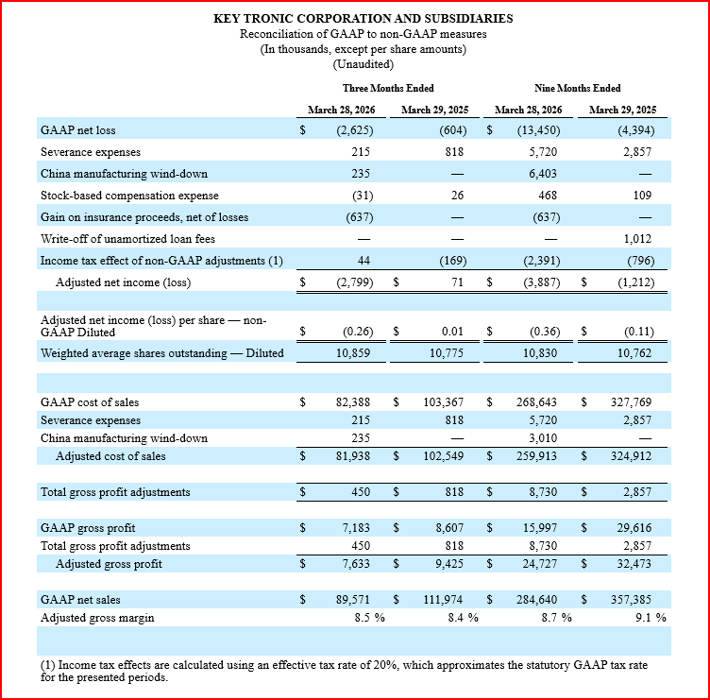
Appendix: Non-GAAP Reconciliations

