Slide 1
Fourth Quarter and Year End of Fiscal 2026 Earnings Call
August 27, 2026

Slide 2
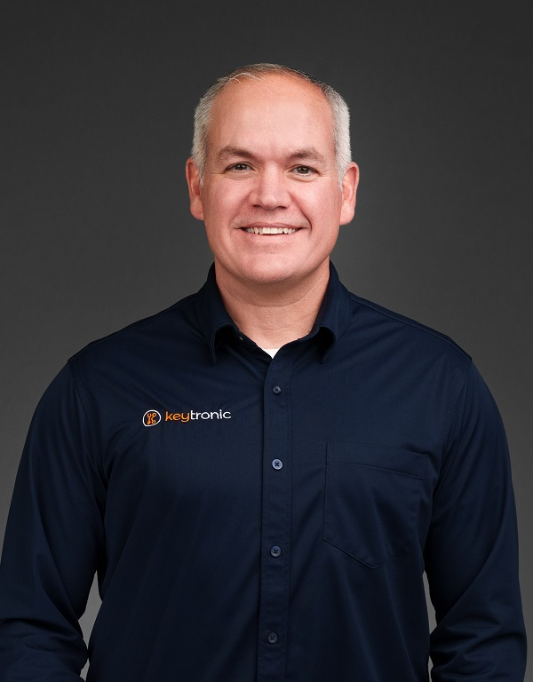

Management On Call Today
Brett Larsen
President and CEO
Tony Voorhees
CFO
2

Slide 3
Notices and Disclaimers
Forward-Looking Statements
Some of the statements in this presentation are forward-looking statements within the meaning of the Private Securities Litigation Reform Act of 1995. Forward-looking statements include, but are not limited to those including such words as aims, anticipates, believes, continues, estimates, expects, hopes, intends, plans, predicts, projects, targets, will, or would, similar verbs, or nouns corresponding to such verbs, which may be forward looking. Forward-looking statements also include other passages that are relevant to expected future events, performances, and actions or that can only be fully evaluated by events that will occur in the future. Forward-looking statements in this presentation include, without limitation, the Company’s statements regarding its expectations with respect to financial conditions and results, including revenue, earnings, and margins, the Company’s plans to address production constraints, including its ability to access additional capital, the Company’s ability to shift its focus in China and build out production capacity in the US and Vietnam and the timing of completion of those facilities, cost savings from headcount reduction and the wind-down of manufacturing operations in China, demand for certain products and the effectiveness of some of its programs, business from customers and programs, new program launches, impacts from operational streamlining and efficiencies, including reductions in inventories, future utilization of certain tax benefits, and impacts of repairs to its facilities from winter storm damage. There are many factors, risks and uncertainties that could cause actual results to differ materially from those predicted or projected in forward-looking statements, including but not limited to: the future of the global economic environment and its impact on our customers and suppliers; the impact of new governmental legislation and regulation, including tax reform, tariffs and related activities, such as trade negotiations and other risks; the success and timing of our expansion plans; the availability of components from the supply chain; the availability of a healthy workforce; the accuracy of suppliers’ and customers’ forecasts; development and success of customers’ programs and products; timing and effectiveness of ramping of new programs; success of new-product introductions; the risk of legal proceedings relating to the previously reported financial statement restatements and related material weaknesses, the May 2024 cybersecurity incident and the subject of the internal investigation by the Company’s Audit Committee and related or other unrelated matters; acquisitions or divestitures of operations or facilities; technology advances; changes in pricing policies by the Company, its competitors, customers or suppliers; and other factors, risks, and uncertainties detailed from time to time in the Company’s SEC filings.
Available Information and Risk Factors
We file annual, quarterly and current reports and other information with the SEC. The SEC filings are available on our website (www.keytronic.com/investor-relations/sec-filings/) and at the SEC’s website (www.sec.gov). These filings describe some of the risks and uncertainties that could affect our business and cause our actual results to differ materially from past or projected results. You should review these filings as they may contain important information about us and our business.
Non-GAAP Financial Measures
This presentation contains certain non-GAAP financial measures, adjusted net income (loss), adjusted net income (loss) per share, adjusted cost of sales, adjusted gross profit, and adjusted gross margin. We provide these non-GAAP financial measures because we believe they provide greater transparency related to our core operations and represent supplemental information used by management in its financial and operational decision making. Additional information about, and reconciliations of, these measures are provided at the end of this slide deck and in our earnings release, which is posted to the investor relations section of our website: www.keytronic.com/investor-relations/press-releases/.
3

Slide 4
Revenue Highlights
 | FY2026 | FY2025
Fourth Quarter | $102.0M | $110.5M
Third Quarter | $89.6M | $112.0M
Full Year | $386.7M | $467.9M
  Sequential increase driven by strong demand from legacy and new programs
  Vietnam-based production more than doubled sequentially
  Tightening credit availability and liquidity pressures across global supply chain
  Delayed ~$10 million of shipments during the quarter
  Expecting continued revenue growth in coming quarters of fiscal 2027
4

Slide 5
Margins
 | Q4-FY2026 | Adjusted Q4-FY2026 | Q4-FY2025
Gross Margin | 7.8% | 8.3% | 6.2%
Operating Margin | (3.6%) | N/A | (2.1%)
  Gross margin improvements despite adverse supply chain challenges and lower revenue levels
  Operating efficiencies gained from cost-cutting initiatives
  Operating margin for the fourth quarter of fiscal 2026 was adversely impacted by an $8.4 million write off of long-term receivables for distressed customers and related legal costs
  China wind-down expected to save ~$4.0M in fiscal 2027
  Expect margins to strengthen on higher revenue
5

Slide 6
Earnings – GAAP
 | Q4-FY2026 | Q4-FY2025
Net Loss | ($34.3M) | ($3.9M)
Net Loss Per Share – Diluted | ($3.16) | ($0.36)
 | FY2026 | FY2025
Net Loss | ($47.8M) | ($8.3M)
Net Loss Per Share – Diluted | ($4.41) | ($0.77)
6

Slide 7
Earnings – Non-GAAP
 | Q4-FY2026 | Q4-FY2025
Adjusted Net Income (Loss) | ($2.9M) | ($3.8M)
Adjusted Net Income (Loss) Per Share – Diluted | ($0.26) | ($0.35)
 | FY2026 | FY2025
Adjusted Net Loss | ($3.7M) | ($5.0M)
Adjusted Net Loss Per Share – Diluted | ($0.34) | ($0.47)
7

Slide 8
Balance Sheet and Cash Flow Highlights
 | FY2026 | FY2025 | % Change
Inventory | $95.8M | $97.3M | -2%
Current Ratio | 2.1 | 2.6 | -19%
DSOs | 75 | 86 | -13%
Capital Expenditures (YTD) | $6.4M | $4.1M | 56%
8

Slide 9
Outlook
  Continue to face global economic uncertainties and volatile trade policies, but believe customers adjusting to new normal
  Gradually increased demand from several longstanding customers and new programs ramping
  Expect growth in US and Vietnam
  Improved operating efficiency making us more competitive => stronger pipeline of new business
  Production backlog has grown and increasingly well positioned to win new programs and profitably expand business
  Not issuing guidance for first quarter of fiscal 2027
9

Slide 10
Fiscal 2026 Highlights
Strengthened competitive position and created more efficient global manufacturing footprint
  Exited manufacturing operations in China
  Right-sized Mexico facility
  Expanded production capacity in US and Vietnam
Improved cost structure, enhanced supply chain flexibility, and enabled customers with attractive manufacturing options
Expect revenue to continue to grow and return to profitability in fiscal 2027
10

Slide 11
Major Cost-Cutting in China and Mexico
China operations:
  Completed wind down in China and transferred several programs to Vietnam
  Anticipate savings from shutdown to be approximately $4 million in fiscal 2027
  Continue to operate in China with small team focused on sourcing
Mexico operations:
  Over past 27 months, reduced headcount by ̴ 40% in Mexico
  Streamlined operations, increased efficiencies and invested in automation
  Mexico facility offers unique solution for tariff mitigation under USMCA
  More competitive manufacturing footprint enabling us to capture market share and compete for broader range of programs
11

Slide 12
Expanding US and Vietnam Production
US facilities:
    New clean-tech, cutting-edge manufacturing and R&D operations in Arkansas
    Provides customers with enhanced engineering support, faster collaboration, and increased manufacturing flexibility
    Expect double-digit growth in Arkansas in FY 2027
  Vietnam facilities:
    Doubled capacity and added medical device capabilities
    Providing highly competitive combination of quality, low cost, and regional supply chain.
    Expected to play major role in long-term growth and increasingly important differentiator
  Approximately half of manufacturing took place in US and Vietnam during fourth quarter
  Exceptionally well positioned for customers seeking to nearshore production, diversify manufacturing locations, and reduce overall supply chain risk
  Strong foundation for sustainable growth and improved profitability in years ahead
12

Slide 13
Expanding Customer Base in FY2026
Medical devices
Industrial equipment
Automotive technology
Pest control
Construction equipment
Data centers
Power management
Traction in steady growth sectors
  Utilities and data centers
Many new programs feature innovative partnership models => more balanced approach to ramp-up capital requirements
New business underscores continued trend towards on-shoring and dual sourcing
13

Slide 14
Key Competitive Advantages
Enhanced flexibility, competitiveness, and resilience of global manufacturing network
Engineering and design services remain one of most powerful differentiators
Broad range of vertically integrated manufacturing capabilities and decades of process expertise

Slide 15
Looking Forward
Global market uncertainties creating major near-term challenges but driving favorable long-term trends
Expecting revenue growth in coming quarters from legacy customers and new programs in U.S., Mexico and Vietnam
Encouraged by cost reductions, increasing cash flow generated from operations, enhanced global manufacturing footprint, and innovations from design engineering
Initiatives have increased potential for profitable growth
15

Slide 16
Thank You to Our Dedicated Employees
Challenging year for industry and for Key Tronic
Execution of strategy made possible by our investments in plants and equipment ̶ but even more so because of the skills, local knowledge and talents of our people
Many thanks to our exceptional employees for their dedication and hard work
16

Slide 17
Q & A
17

Slide 18
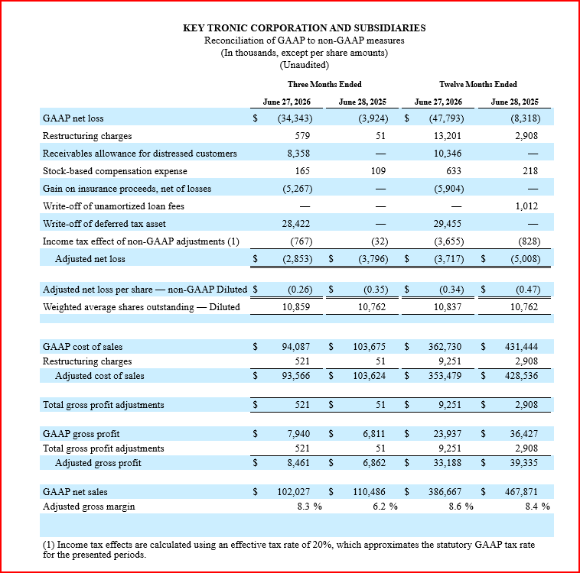
Appendix: Non-GAAP Reconciliations
18

